Slide 1
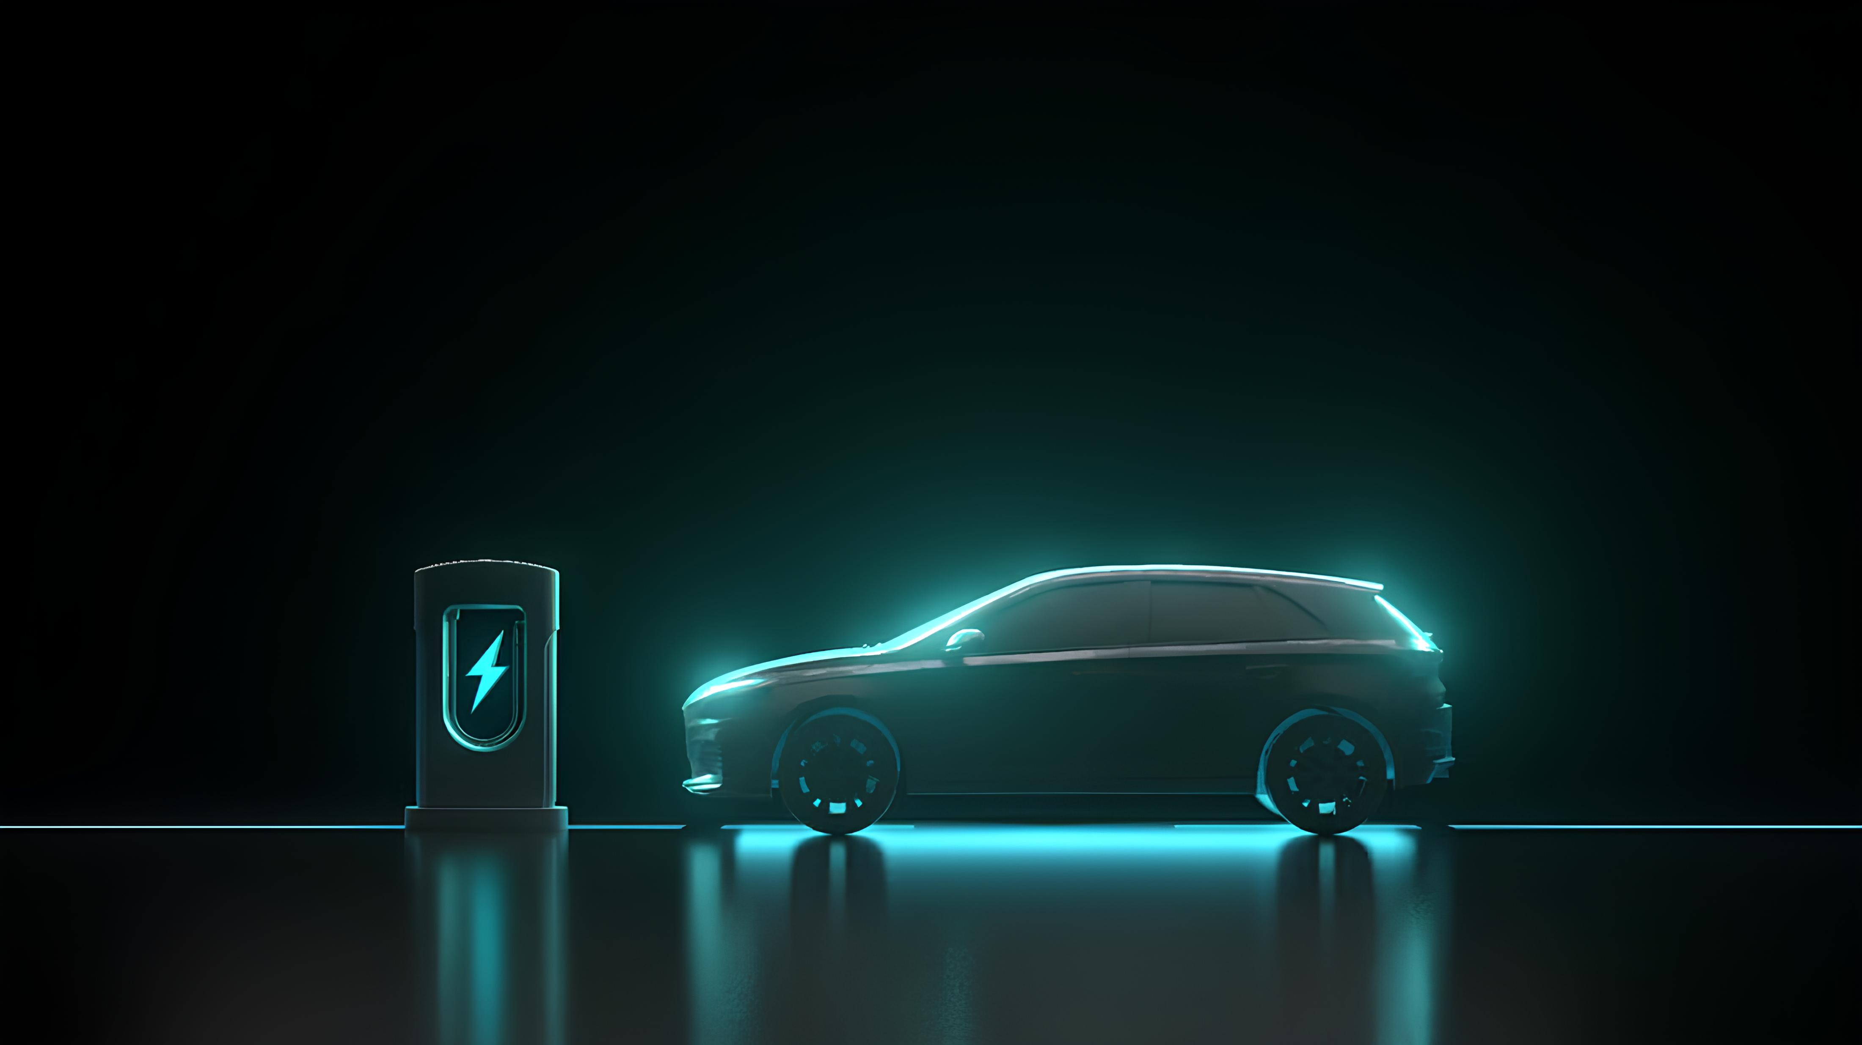
Electric Vehicle (EV) Charging Network
Management System

Slide 2
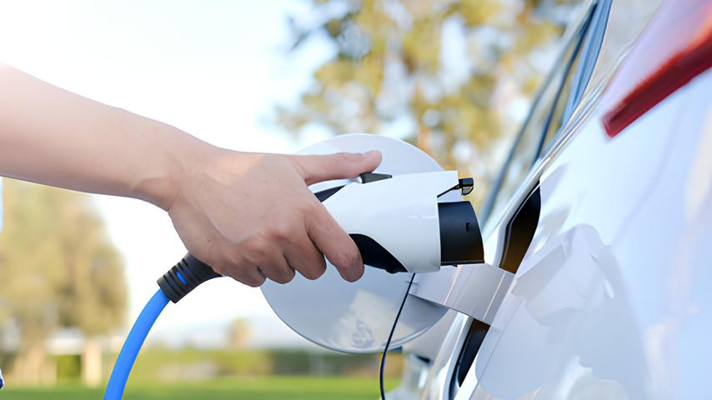
Abstract
With the rise of electric vehicles, the need for proper charging systems is growing quickly. This system is about an EV Charging Management System using a database. The system stores details about users, their vehicles, charging stations, chargers, charging sessions, and payments.
This database makes it easier to manage EV charging operations, generate useful reports, and analyse usage, costs, and revenue, supporting the move toward cleaner and smarter transportation.

Slide 3
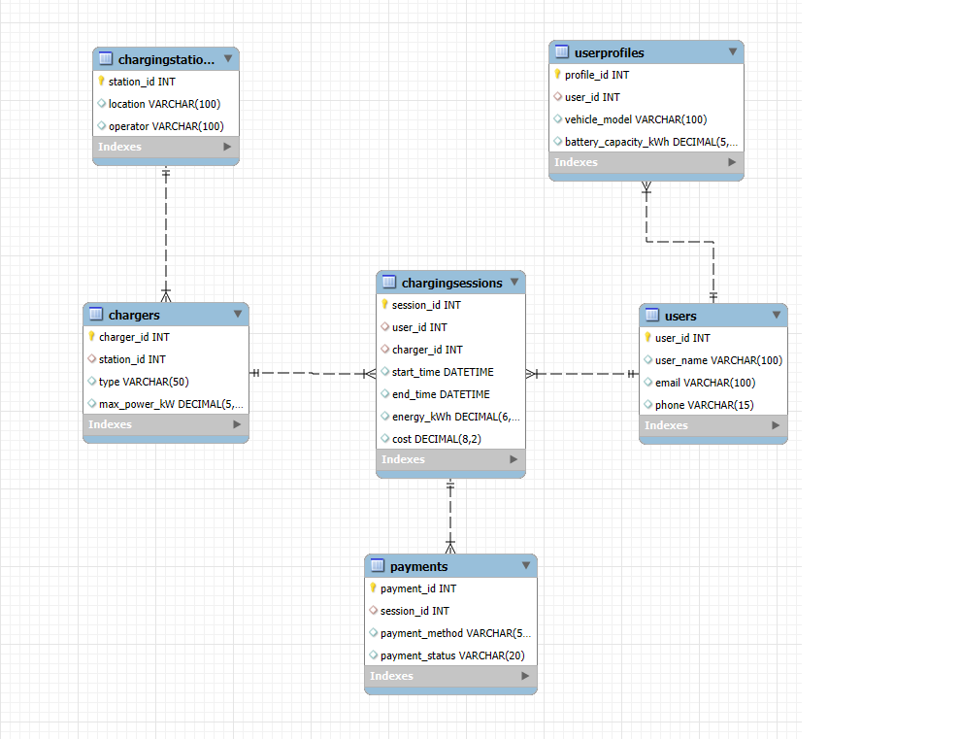
ER-Diagram

Slide 4
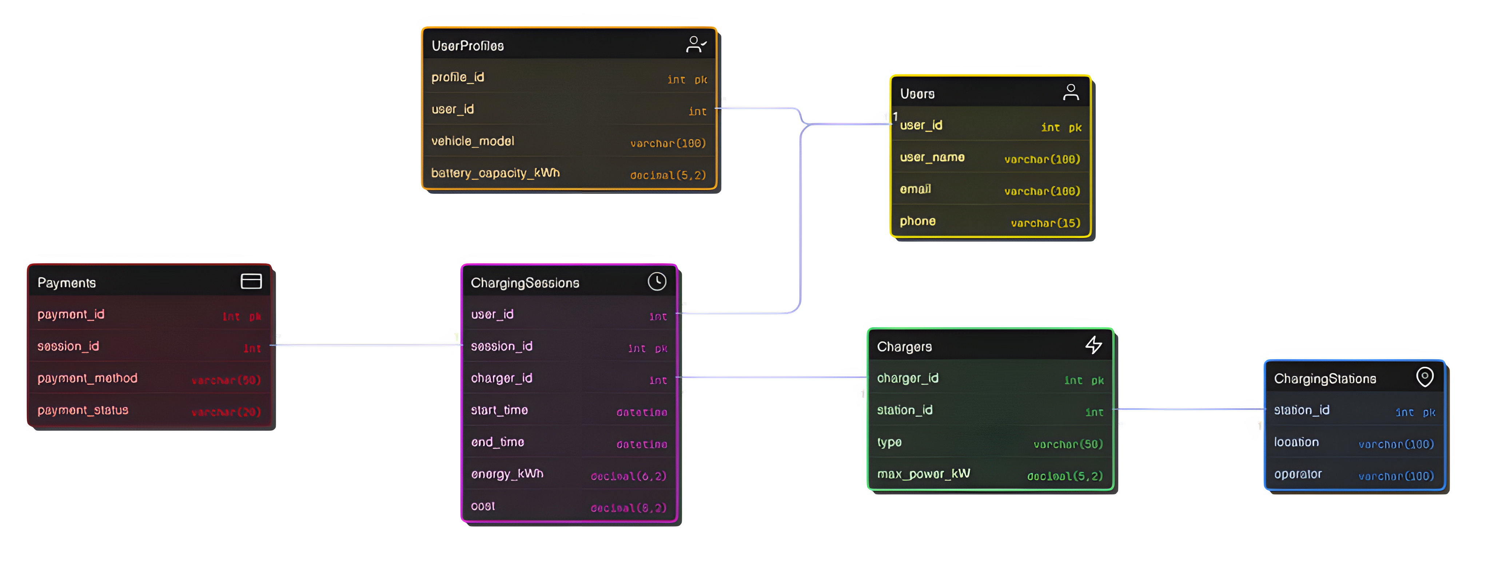
ER-Diagram

Slide 5
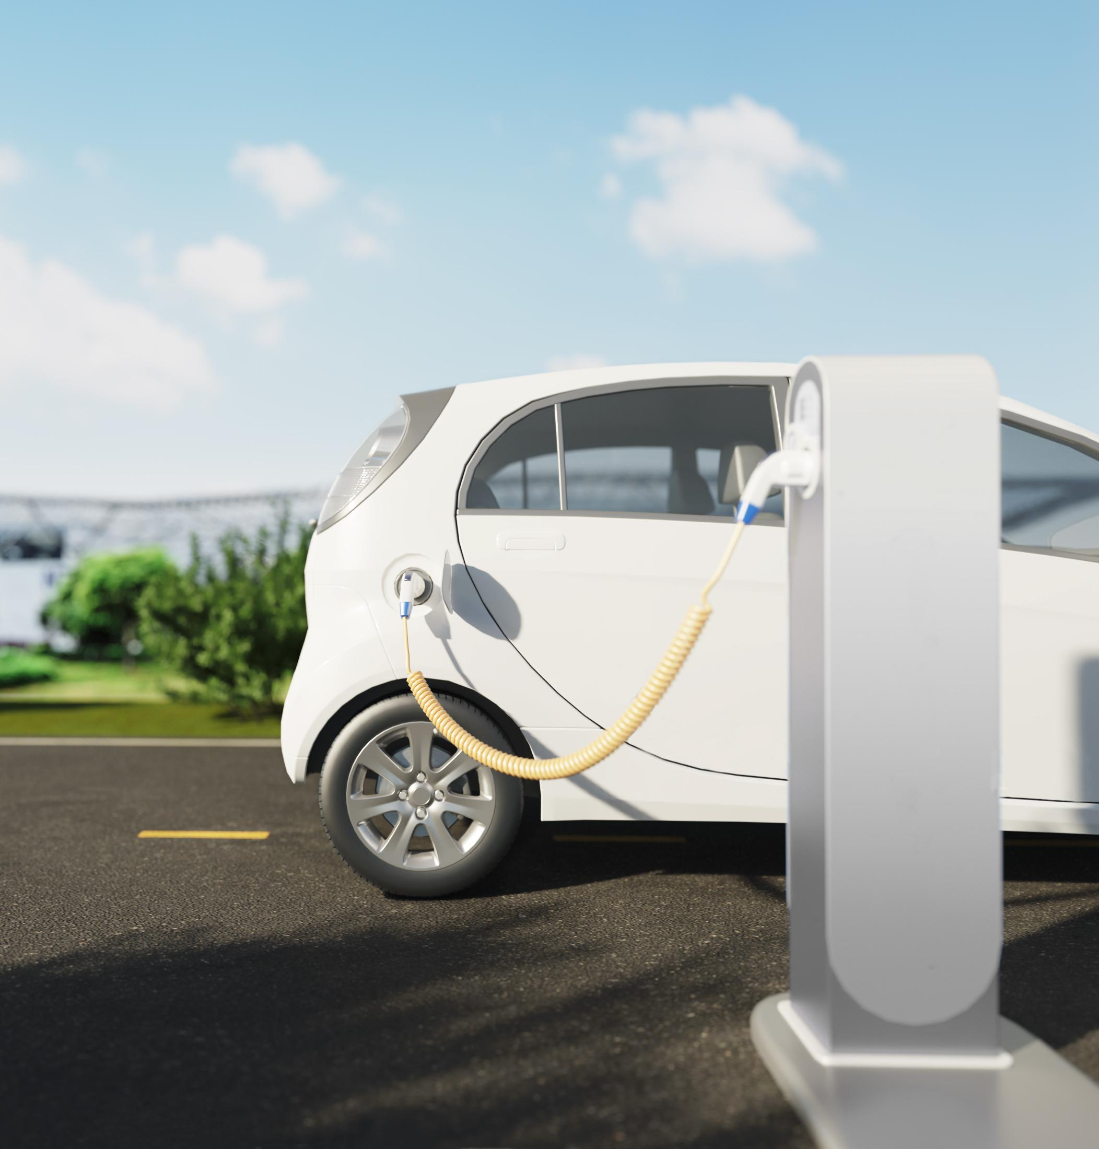
Structure of Table

Slide 6
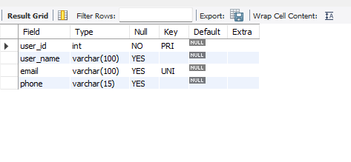
Users Table
Stores the people using EV charging services.
user_id → Unique ID for each user (primary key).
user_name → User’s full name.
email → Unique email address
phone → Contact number
SYNTAX: desc users;

Slide 7
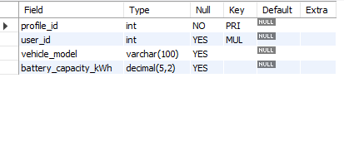
User_profile Table
Each user has one EV profile, storing vehicle info.
profile_id → Unique ID for the profile (primary key).
user_id → Links to Users.user_id.
vehicle_model → EV model (e.g., Tesla Model 3, Tata Nexon EV).
battery_capacity_kWh → Size of the EV battery (in kWh)
SYNTAX: desc users_profile;

Slide 8
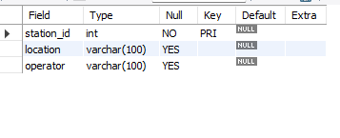
ChargingStations Table
Physical charging locations.
station_id → Unique station identifier.
location → Address or area of the station.
operator → Company running the station (e.g., Tata Power, Ionity).
SYNTAX: desc chargingstations;

Slide 9
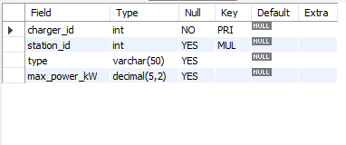
Chargers Table
Each station has multiple chargers of different types.
charger_id → Unique charger identifier.
station_id → Links charger to its station.
type → Charger type.
max_power_kW → Maximum charging power (kW).
SYNTAX: desc chargers;

Slide 10
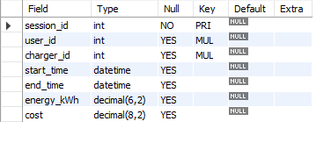
ChargingSessions Table
Each time a user plugs in, a charging session is created.
session_id → Unique session ID.
user_id → Who used the charger.
charger_id → Which charger was used.
start_time → Timestamp when charging started.
end_time → Timestamp when charging ended.
energy_kWh → Total energy consumed (in kWh).
cost → Amount charged for the session.(The rate used in this database is ₹15/kWh)
SYNTAX: desc chargingsessions;

Slide 11
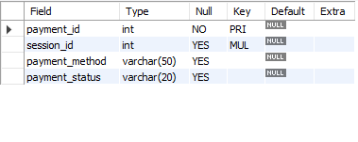
Payments Table
Each session has exactly one payment record.
payment_id → Unique payment identifier.
session_id → An attribute that Links directly to ChargingSessions.session_id .
payment_method → Payment method (Card, Wallet, UPI, NetBanking).
payment_status → Payment status (Success, Pending, Failed, Refunded).
SYNTAX: desc payments;

Slide 12
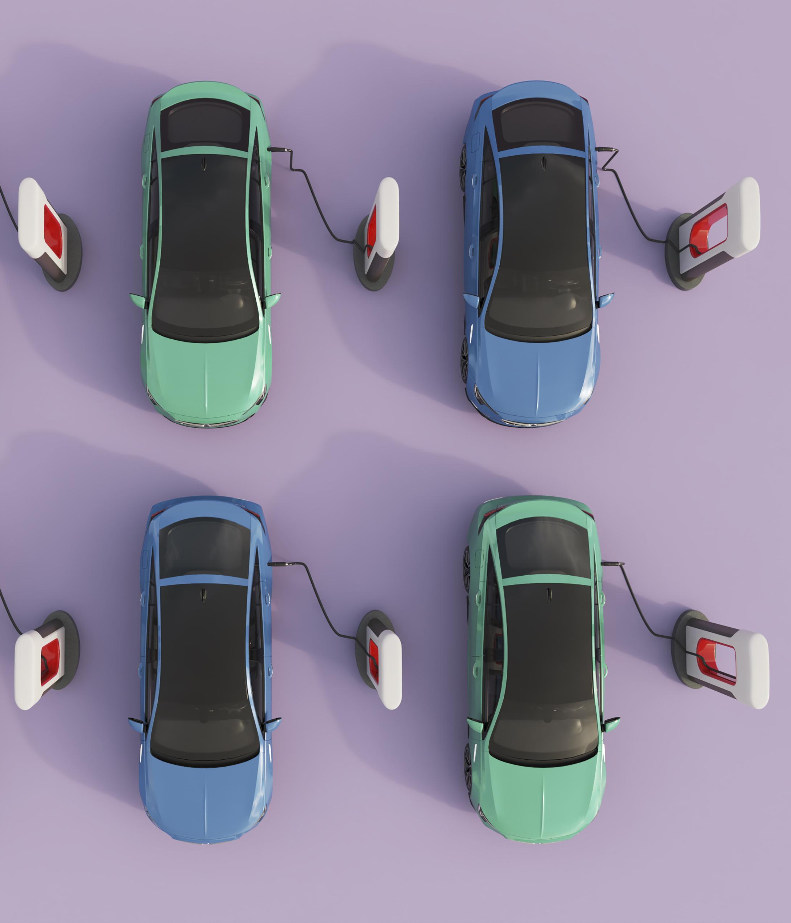
Contents of Table

Slide 13
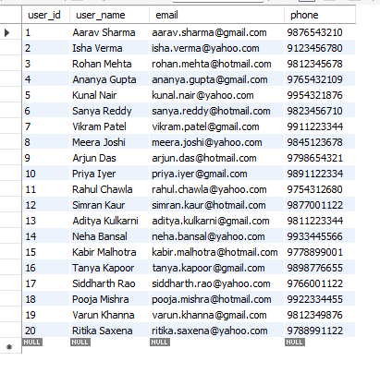
Users Table

Slide 14
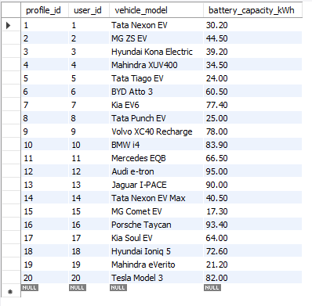
User_profiles Table

Slide 15
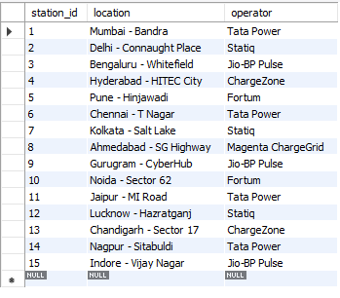
ChargingStations Table

Slide 16
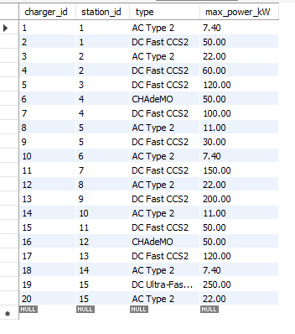
Chargers Table

Slide 17
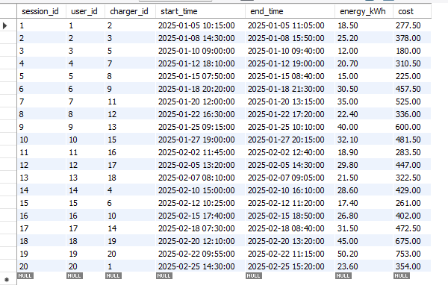
ChargingSessions Table

Slide 18
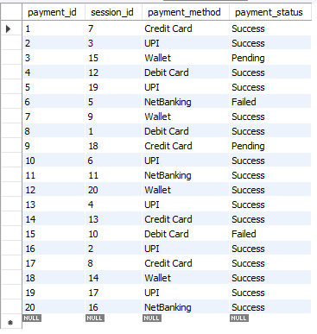
Payments Table

Slide 19

SUB QUERIES

Slide 20
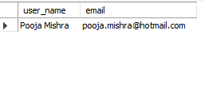
SUBQUERY
Display the name and email of the user who has used the fastest charger (highest max_power_kW).
SYNTAX:
select user_name, email from Users
where user_id = (select user_id from ChargingSessions
where charger_id = ( select charger_id from Chargers
order by max_power_kW desc limit 1 ));

Slide 21
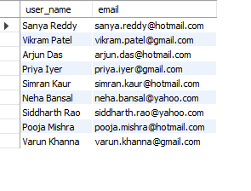
SUBQUERY
Display all users who have paid more than the average cost for a charging session.
SYNTAX:
select user_name, email from Users
where user_id in ( select user_id from ChargingSessions
where cost > (select avg(cost) from ChargingSessions));

Slide 22
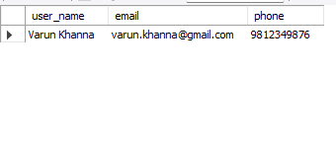
SUBQUERY
Display the user who paid the maximum cost.
SYNTAX:
select user_name, email, phone from users
where user_id = ( select user_id from chargingsessions where cost = (select max(cost) from chargingsessions));

Slide 23
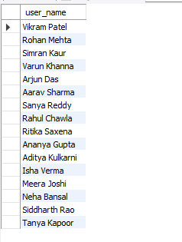
SUBQUERY
Display users who have made at least one payment.
SYNTAX:
select user_name from users where user_id in (
select user_id from chargingsessions where session_id in (
select session_id from payments where
payment_status = 'success' ));

Slide 24
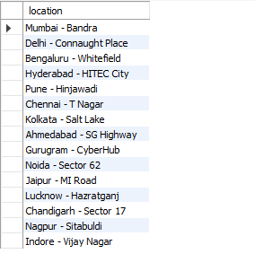
SUBQUERY
Display stations that have at least one charger used in a charging session.
SYNTAX:
select location from chargingstations
where station_id in (select station_id from chargers
where charger_id in (select charger_id
from chargingsessions));

Slide 25
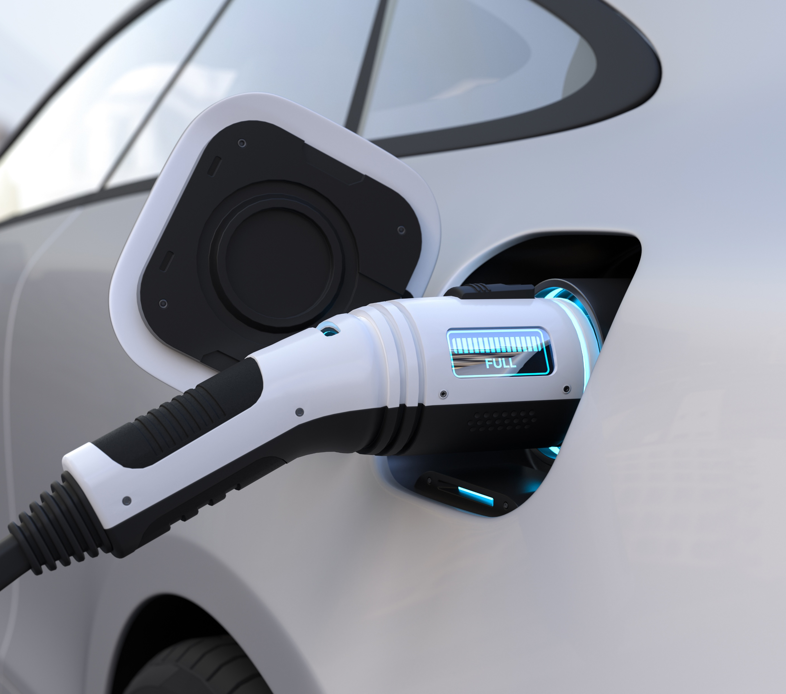
JOINS

Slide 26
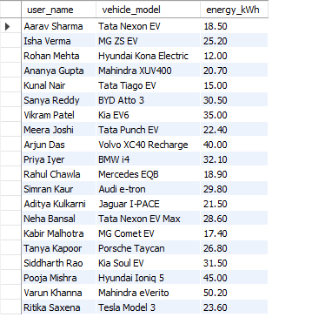
JOINS
Display the user names and the vehicle models they used for charging, along with the energy consumed in that session.
SYNTAX:
select u.user_name, up.vehicle_model, cs.energy_kWh
from Users u
inner join UserProfiles up on u.user_id = up.user_id
inner join ChargingSessions cs on u.user_id = cs.user_id;

Slide 27
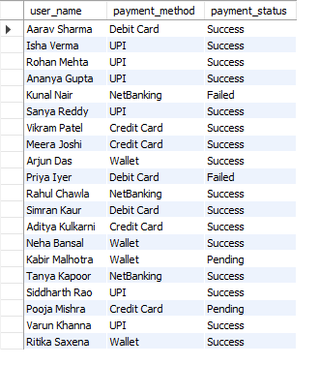
JOINS
Display all users and their payments, including users who haven’t made any payments yet.
SYNTAX:
select u.user_name, p.payment_method, p.payment_status from Users u
left join ChargingSessions cs on u.user_id = cs.user_id
left join Payments p on cs.session_id = p.session_id;

Slide 28
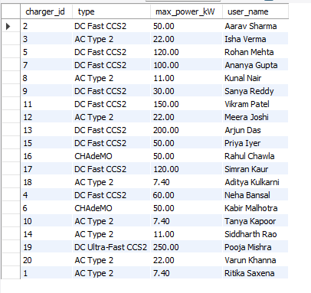
JOINS
Display all chargers and the users who used them, including chargers that haven’t been used yet.
SYNTAX:
select c.charger_id, c.type, c.max_power_kW, u.user_name from Chargers c
right join ChargingSessions cs
on c.charger_id = cs.charger_id
right join Users u on cs.user_id = u.user_id;

Slide 29
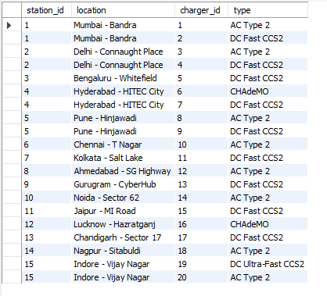
JOINS
Display all stations and chargers.
SYNTAX:
select s.station_id, s.location, c.charger_id, c.type
from ChargingStations s join Chargers c
on s.station_id = c.station_id;

Slide 30
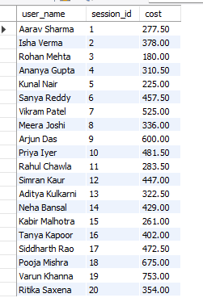
JOINS
Display all users with the total cost of each charging session they made.
SYNTAX:
select u.user_name, cs.session_id, cs.cost from users u
inner join chargingsessions cs on u.user_id = cs.user_id;

Slide 31
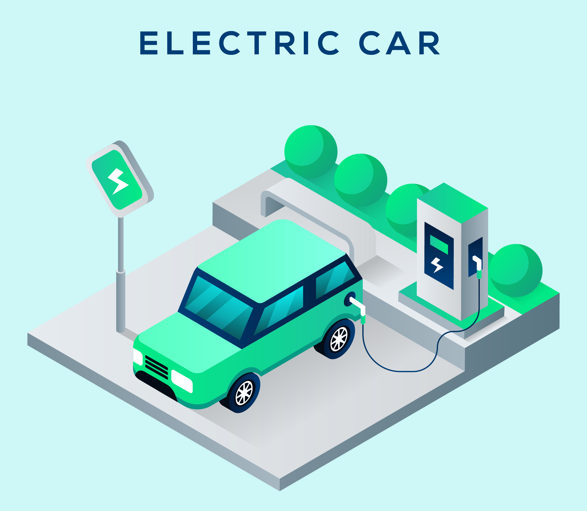
VIEWS

Slide 32
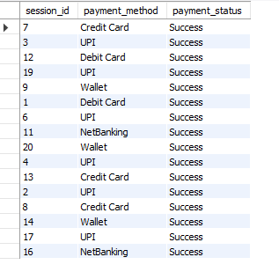
VIEWS
Create a view to list all successful payments with session id and payment method.
SYNTAX:
create view successful_payments as
select session_id, payment_method, payment_status from payments
where payment_status = 'success’;
USAGE:
select * from successful_payments;

Slide 33
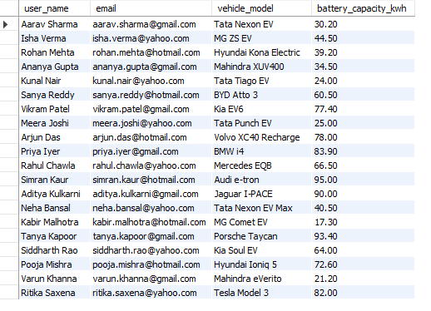
VIEWS
Create a view to show user details with their vehicle information.
SYNTAX:
create view user_vehicle_view as
select u.user_name, u.email, up.vehicle_model, up.battery_capacity_kwh from users u left join userprofiles up on u.user_id = up.user_id;
USAGE:
select * from user_vehicle_view;

Slide 34
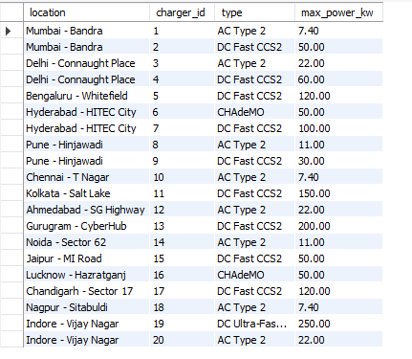
VIEWS
Create a view to show station details with charger types.
SYNTAX:
create view station_charger_view as
select s.location, c.charger_id, c.type, c.max_power_kw from chargingstations s
left join chargers c on s.station_id = c.station_id;
USAGE:
select * from station_charger_view;

Slide 35
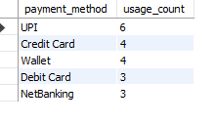
VIEWS
Create a view to show the most used payment method overall.
SYNTAX:
create view popular_payment_method_view as
select payment_method, count(payment_method)
as usage_count from payments group by payment_method order by usage_count desc;
USAGE:
select * from popular_payment_method_view;

Slide 36
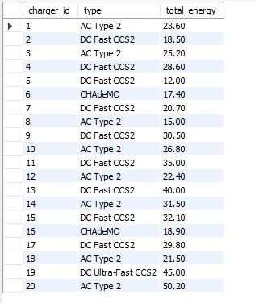
VIEWS
Create a view to show each charger and the total energy delivered.
SYNTAX:
create view ChargerUsage as select c.charger_id, c.type, sum(cs.energy_kWh) as total_energy from Chargers c join ChargingSessions cs on c.charger_id = cs.charger_id group by c.charger_id, c.type;
USAGE:
select * from ChargerUsage;

Slide 37

THANK YOU!
Created By-
NIHAR YELVE
IT VEDANT
T348/DSDA/11-1/PS

